Slide 1

Automatic Labeling of Objects on Footage Collected by Drones
Department of Computer Science and Engineering
Indian Institute of Technology Tirupati
Presented By
Sandeep Kumar (CS24M112)
Ashant Kumar (CS24M113)
Abhishek Kumar (CS24M120)
Dr. Chalavadi Vishnu

Slide 2
01
Introduction

Slide 3
The growing use of drones in surveillance, mapping, and monitoring has created a need for intelligent aerial perception systems.
Object detection are crucial for recognizing and classifying elements in drone-captured images.
This report proposes a unified framework combining tasks to enhance aerial scene understanding.
The approach utilizes the UAVDT-2024 dataset and the Semantic Drone Dataset for detection to train robust models.

Slide 4
02
Implementation of Pipeline

Slide 5
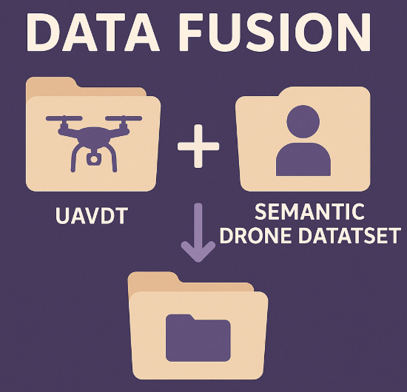
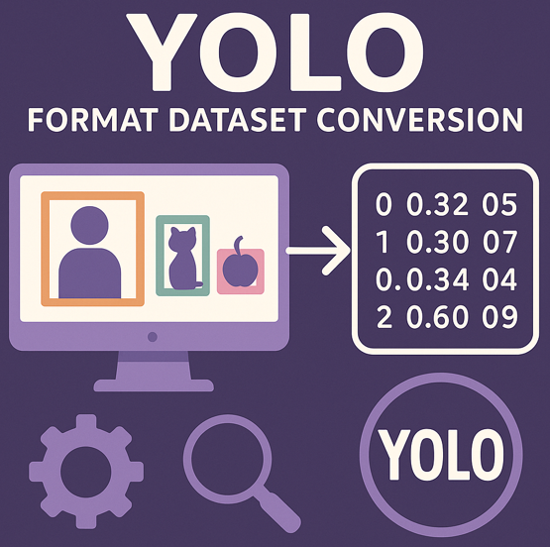

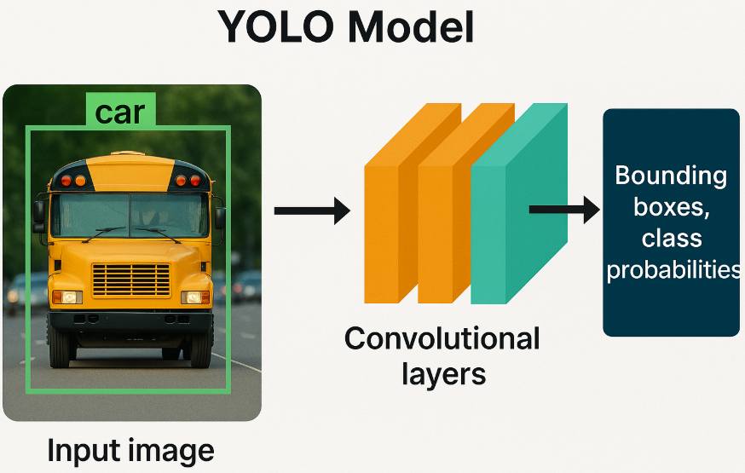
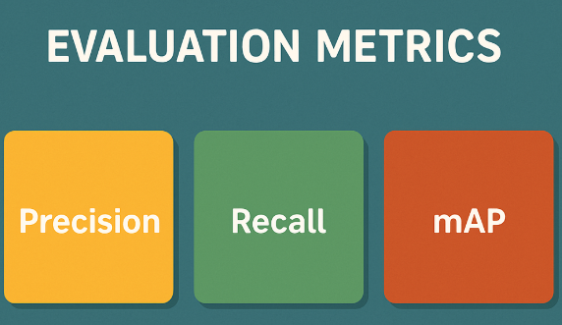
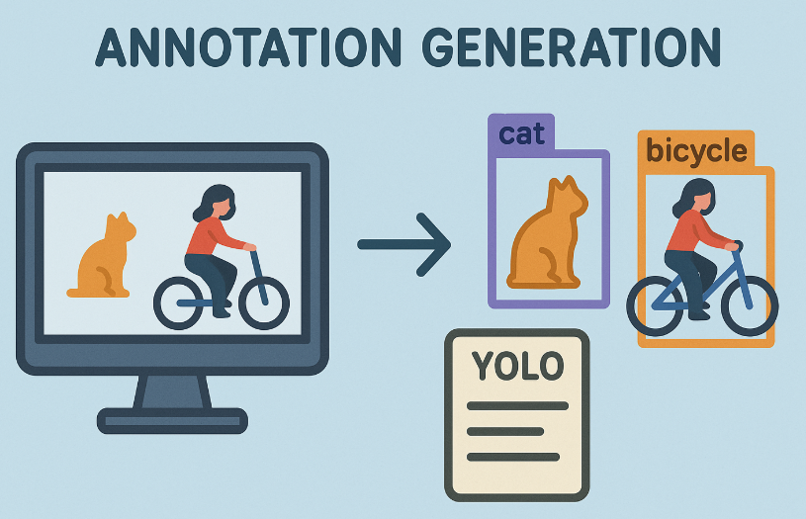
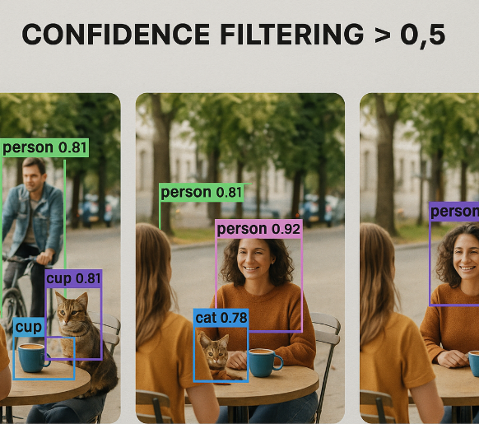
Split Datasets
Normalize Labels
New
Train
Ground Truth
Split the (only new) Dataset
Merge Original and New Dataset (train)
Retrain
Generate Annotations and Save
Filter Annotations

Slide 6
Datasets Used
UAVDT-2024 Dataset
Drone-captured urban/outdoor imagery for object detection
Classes: Car, Truck, Bus, Vehicle
Annotations in a custom format, converted to YOLO format
Semantic Drone Dataset
Provides pixel-level annotations, used to extract bounding boxes
14 semantic classes with unique RGB color codes
Used for object detection only, not semantic segmentation
Bounding boxes are derived from masks and converted to YOLO format

Slide 7
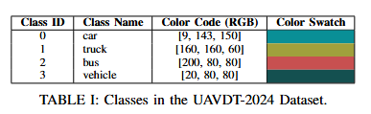
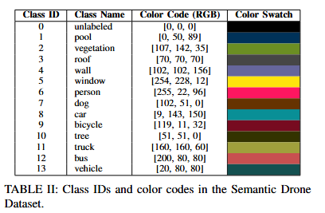
UAVDT-2024 and Semantic Drone Datasets Classes
The annotations in the UAVDT-2024 dataset are in a custom format. These annotations need to be converted into YOLO format for training, where each object is annotated by its class ID, bounding box coordinates, and image dimensions.
The annotations are provided as color-coded segmentation masks, where each pixel corresponds to a specific class, defined by the color code. These masks are used to train segmentation models such as DeepLabV3.

Slide 8
Dataset Details and Preprocessing
YOLO Conversion
UAVDT-2024: Converted to YOLO format – [class_id, x_center, y_center, width, height]
Semantic Drone: Bounding boxes extracted from segmentation masks → YOLO format
Dataset Fusion
Combined UAVDT and Semantic Drone data
Created a unified training set for both detection and segmentation
Enhanced model generalization with diverse aerial scenes

Slide 9
Segregation of dataset into train and validation
Semantic Drone Dataset
copy_split_sequences
normalize_all_labels
Convert Annotations into Yolo Format
Train and Val Splits
Normalize Yolo Labels
Fuse
UAVDT-2024 Dataset
split_and_move_dataset

Slide 10
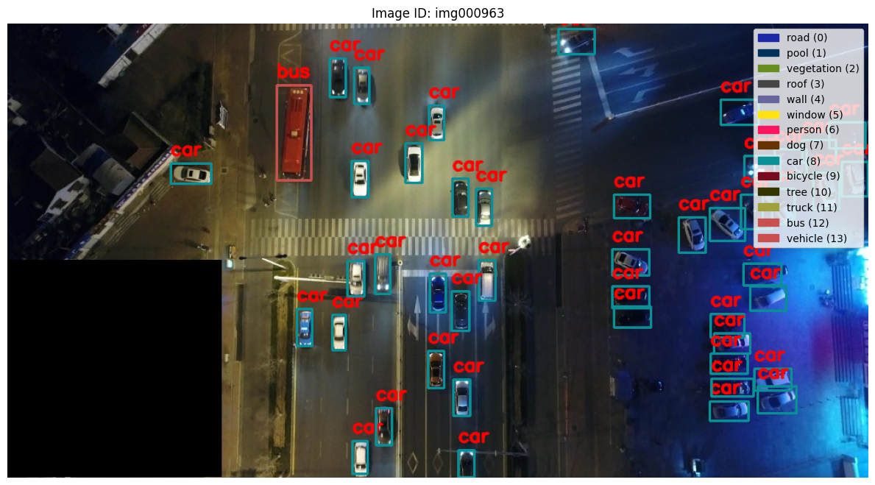

Slide 11
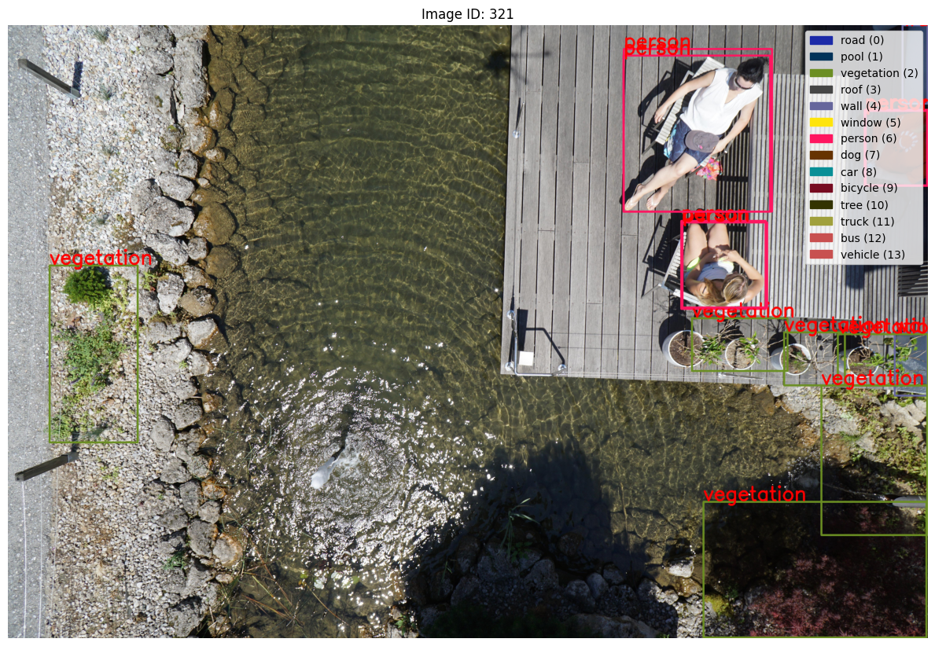

Slide 12
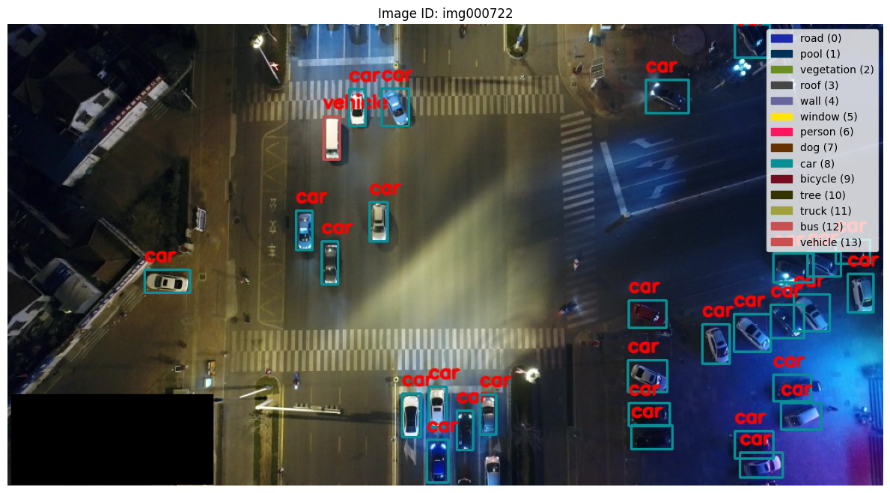

Slide 13
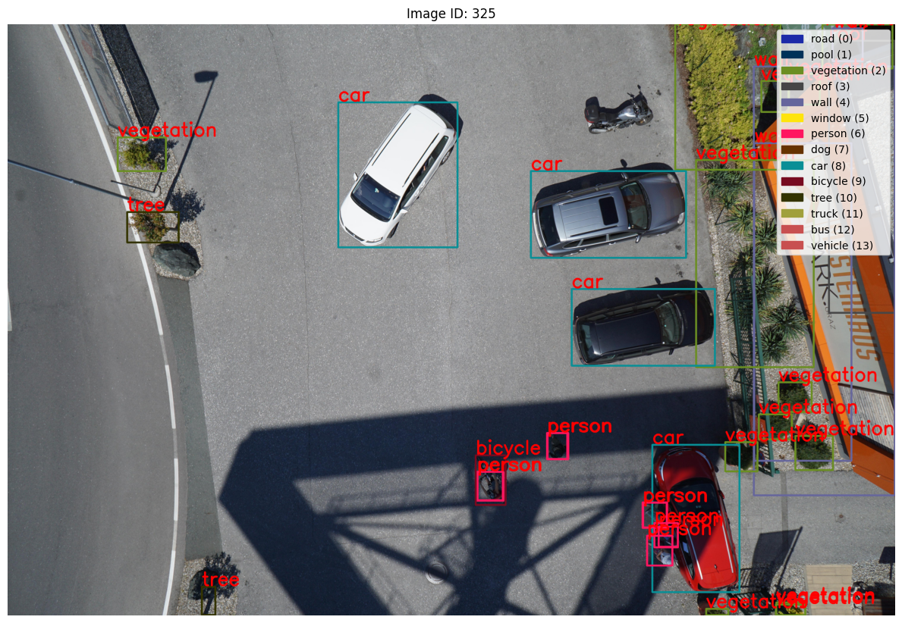

Slide 14
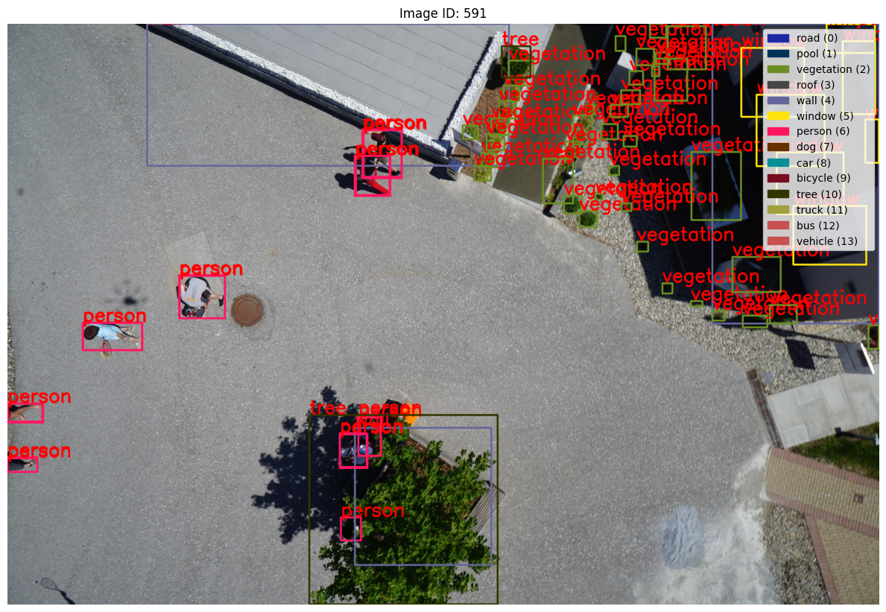

Slide 15
Model Training
A YOLO-based object detection model is trained on the dataset in the YOLO format.
The model learns to detect objects like cars, trucks, and buses based on the bounding box annotations provided in the training data.

Slide 16
Table 1: Dataset & Training Settings
Argument | Value | Description
data | data_yaml | Path to the .yaml file defining dataset (train/val/image paths, class names)
epochs | epochs | Number of training epochs
imgsz | imgsz | Input image size (e.g., 640, 720) – images are resized to imgsz × imgsz
batch | batch | Batch size (number of images per GPU per iteration)
name | name | Name of the training run
project | "runs_yolo/train" | Directory where logs, weights, and results are saved
patience | 20 | Early stopping if no improvement for this many epochs
verbose | True | Enables printing of training logs and metrics

Slide 17
Table 2: Data Augmentation Options
Argument | Value | Description
augment | True | Enables all supported augmentations
degrees | 10 | Max rotation angle applied randomly
scale | 0.5 | Image scaling factor: zoom in/out within 0.5× to 1.5×
flipud | 0.2 | Vertical flip probability
fliplr | 0.5 | Horizontal flip probability
hsv_h | 0.015 | Hue jitter intensity
hsv_s | 0.7 | Saturation jitter intensity
hsv_v | 0.4 | Brightness jitter intensity

Slide 18

Prediction, Confidence Score Filtering and Annotation Generation Video Frames
Filtering annotations based on high confidence
Prediction for the video datasets
Annotation Generation of Videos Which have high confidence

Slide 19
Prediction, Confidence Score Filtering and Annotation Generation Video Frames
The trained YOLO model is applied to video frames to detect objects in real-time.
The model outputs bounding boxes for detected objects with confidence scores indicating the likelihood of correct predictions.
The detected bounding boxes are filtered by confidence score (e.g., threshold = 0.5).
Only boxes with confidence scores higher than the threshold are retained for further annotation. This ensures that only the most reliable detections are considered for retraining.
The filtered bounding boxes, along with their class labels and coordinates, are saved as annotations.
These annotations represent the detected objects and are used for model retraining in the next iteration.

Slide 20
Model Retraining with New Annotations
The new annotations, along with the original training set, are fed back into the model for retraining.
This iterative process improves the model's detection accuracy by reinforcing object recognition from the auto-labeled data.
Retrain
Metrics

Slide 21
03
Predictions on Images

Slide 22
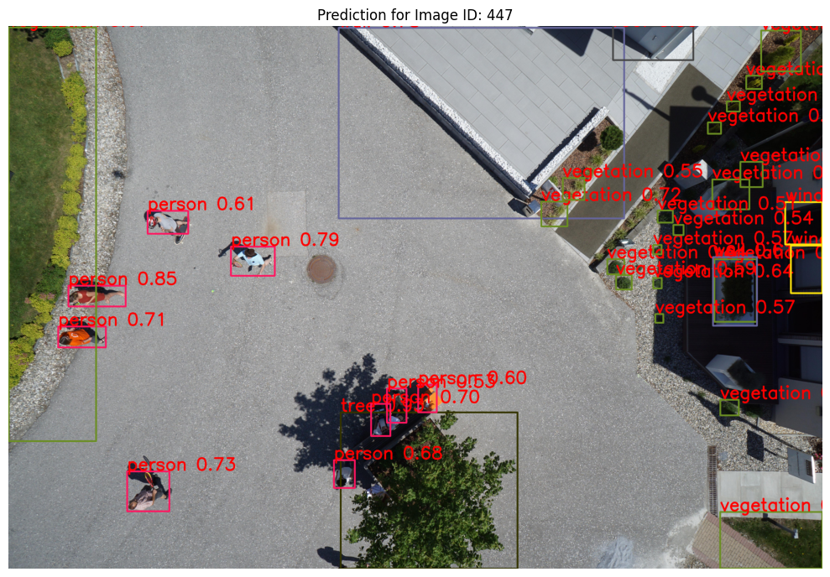

Slide 23
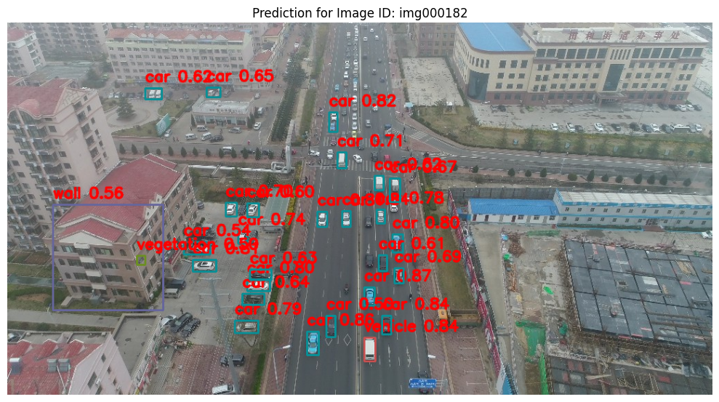

Slide 24
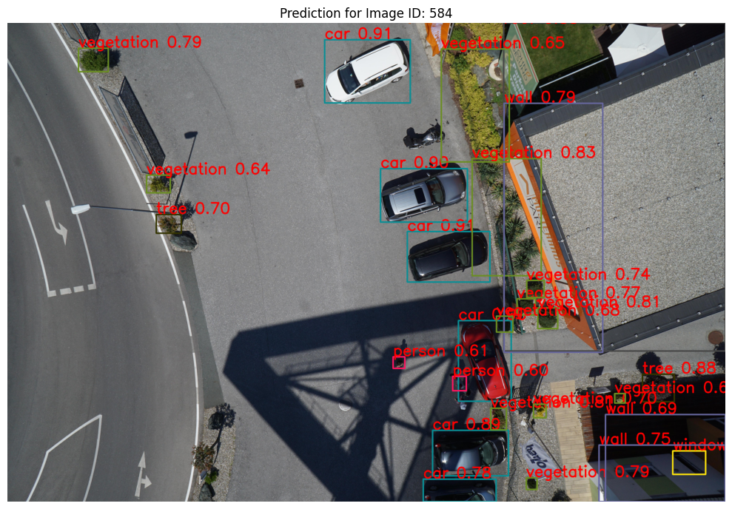

Slide 25
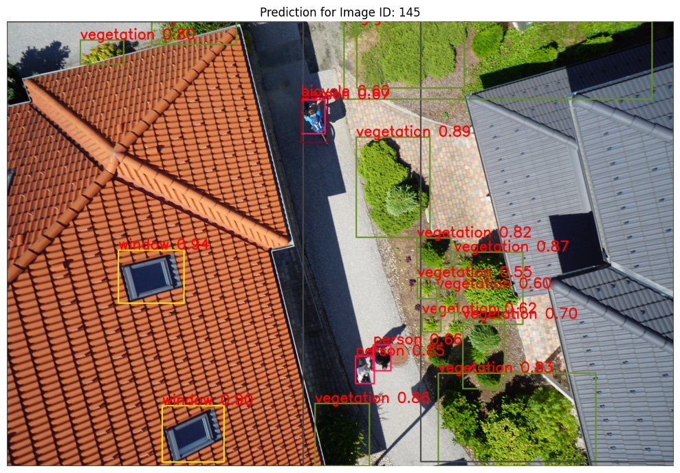

Slide 26
04
Prediction on Videos

Slide 27
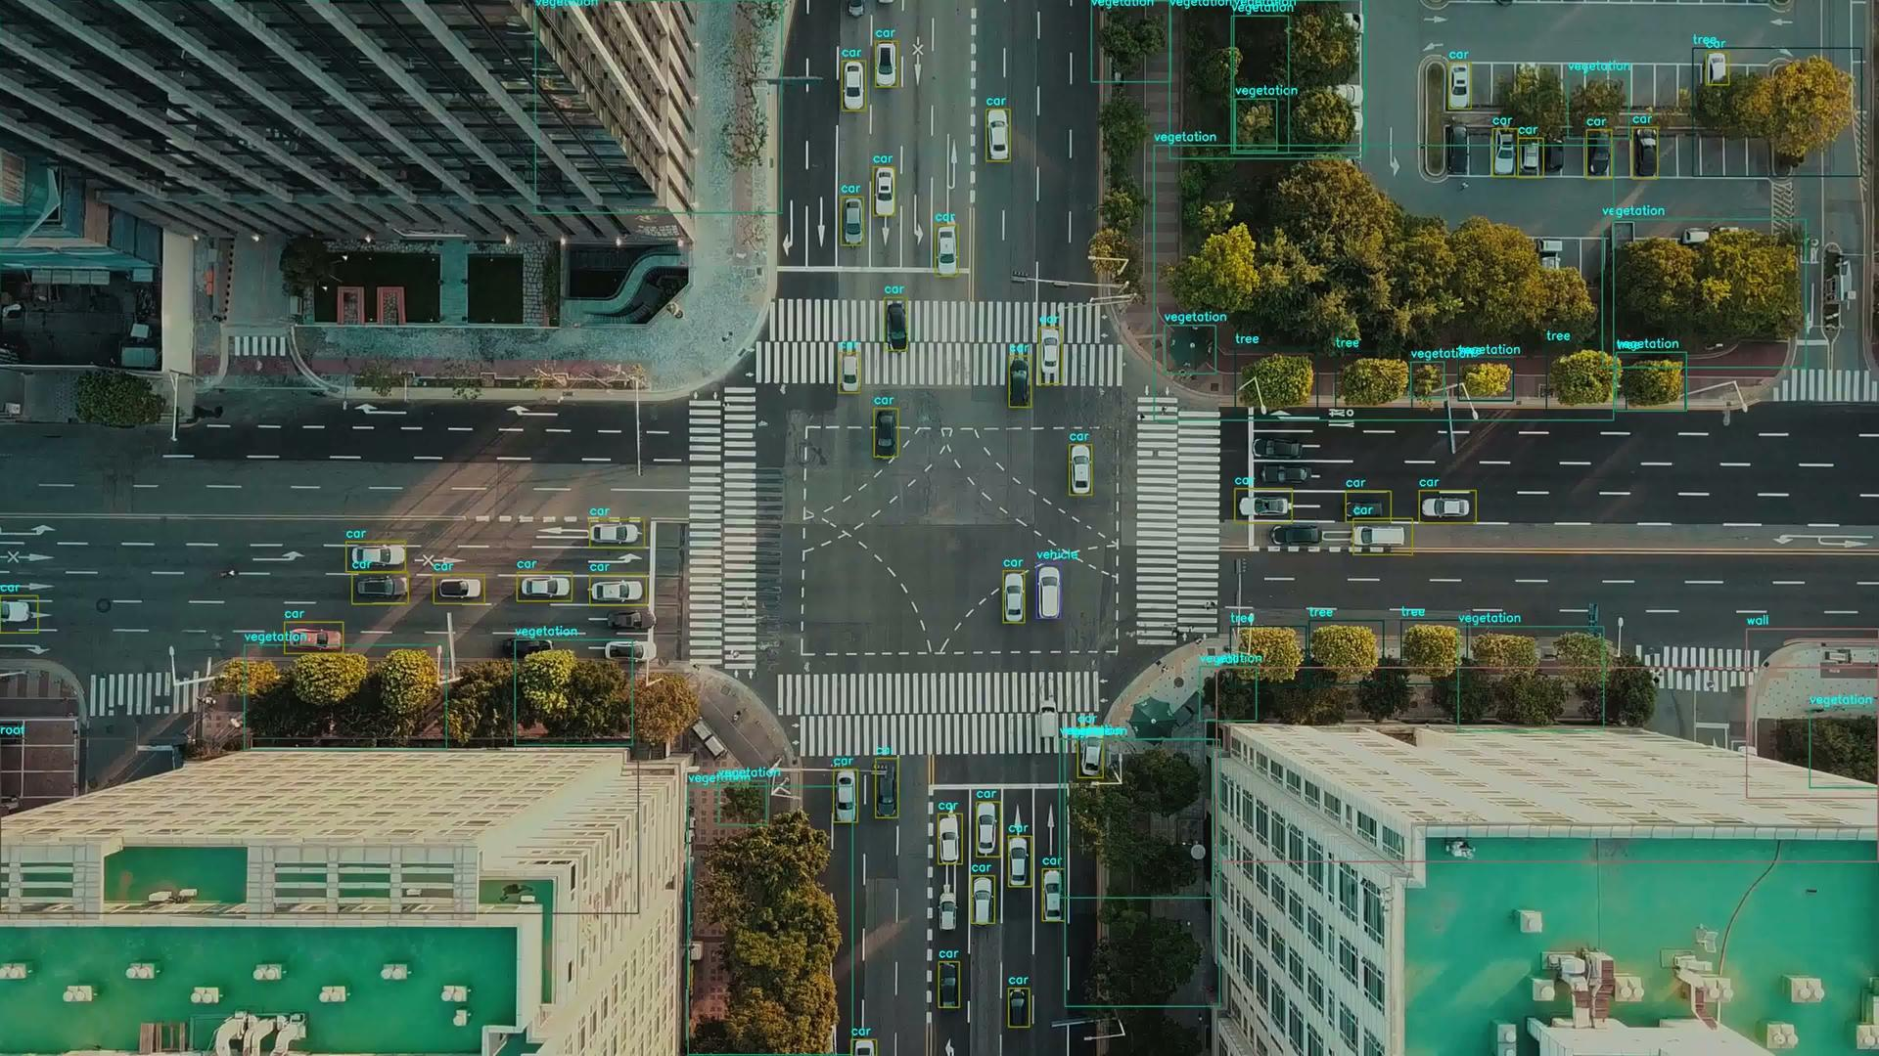

Slide 28
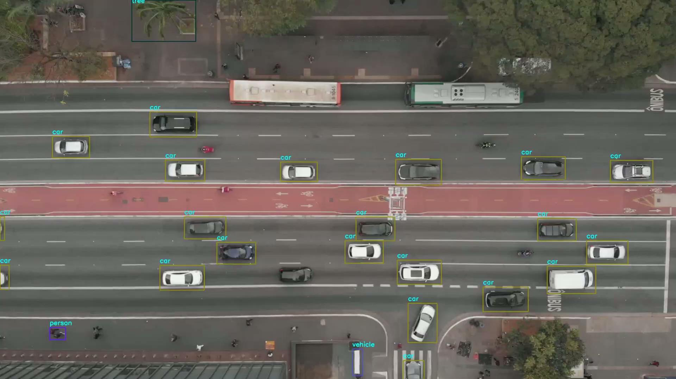

Slide 29
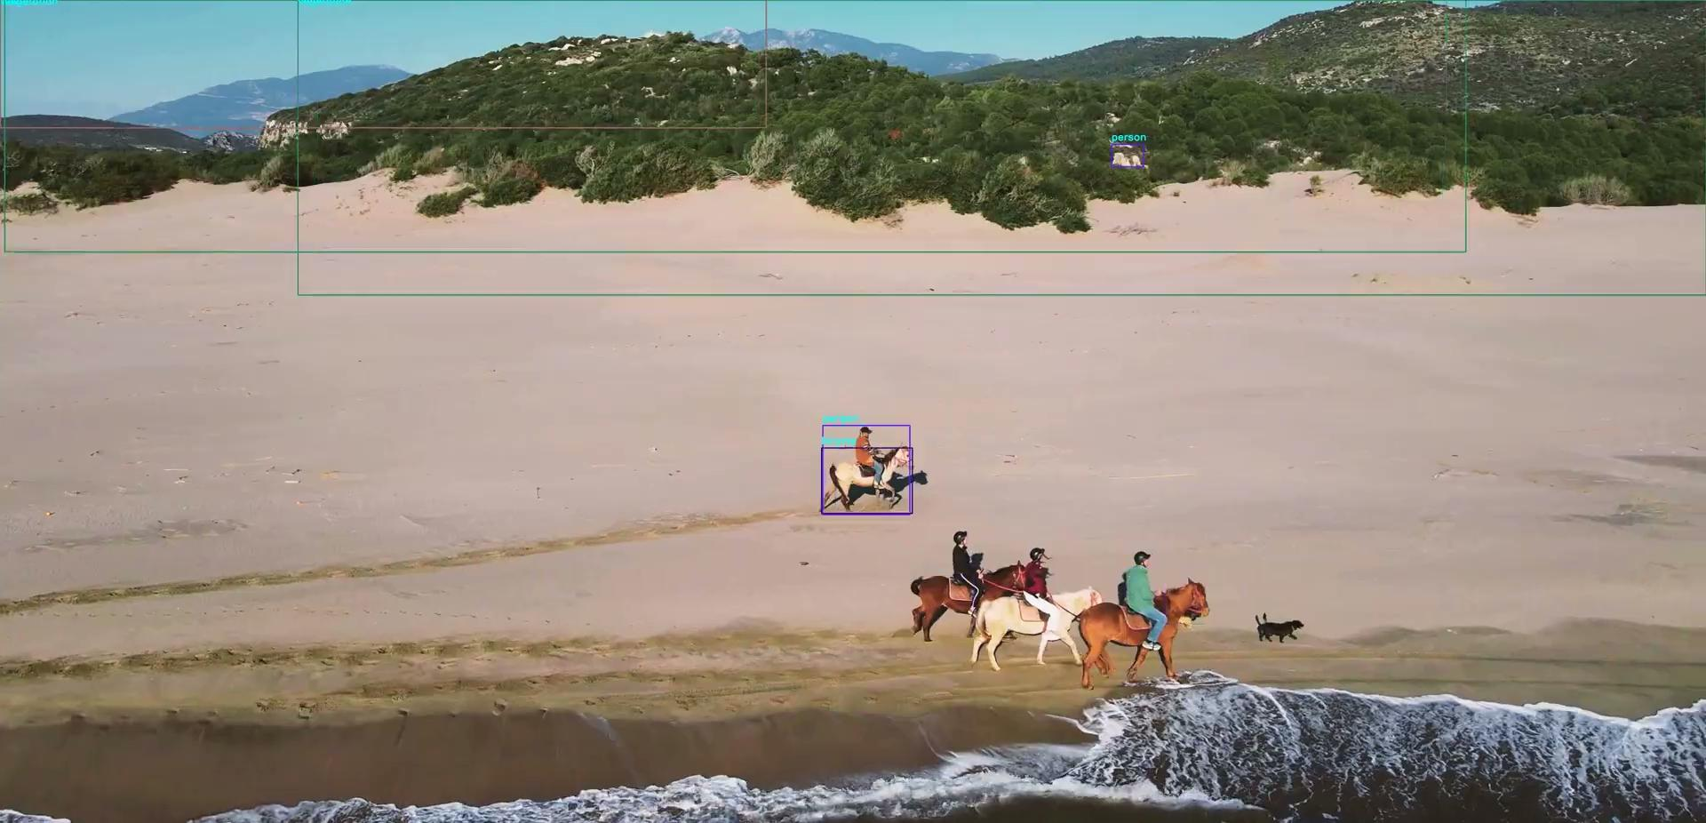

Slide 30
05
Comparison between before and After Retrain

Slide 31
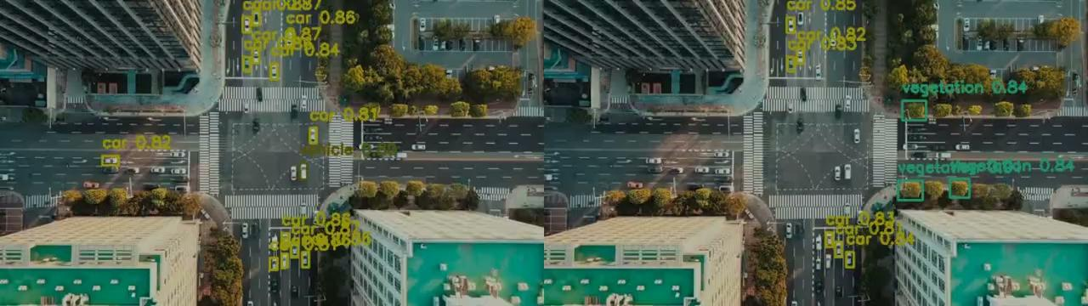

Slide 32
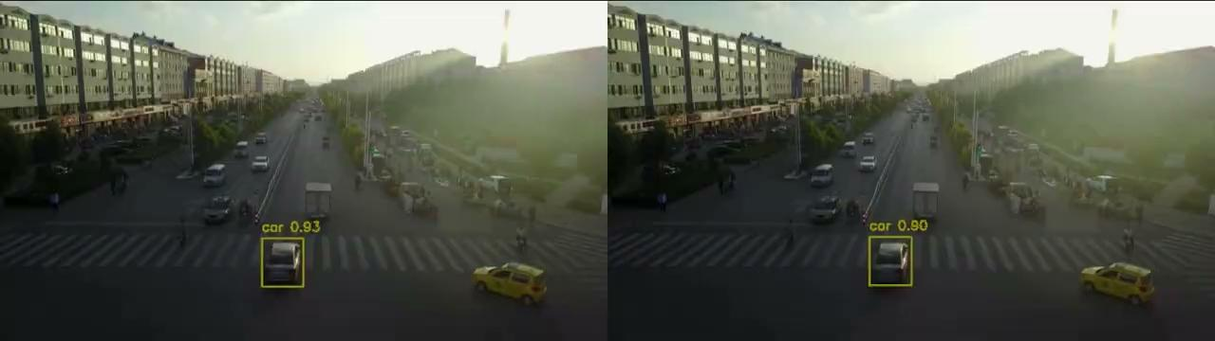

Slide 33
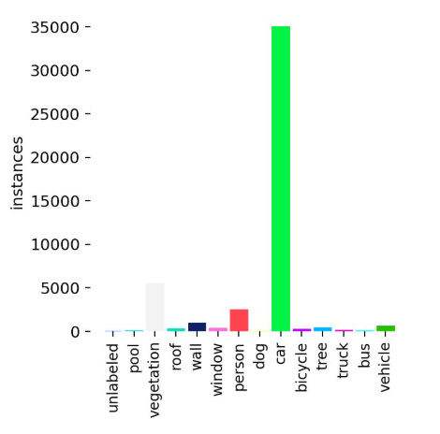
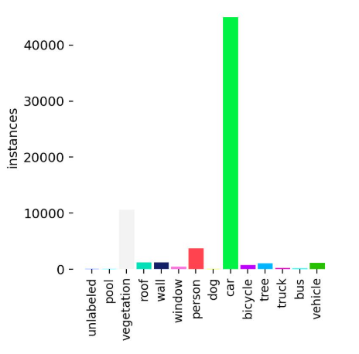
Before Retrain and After Retrain Instances

Slide 34
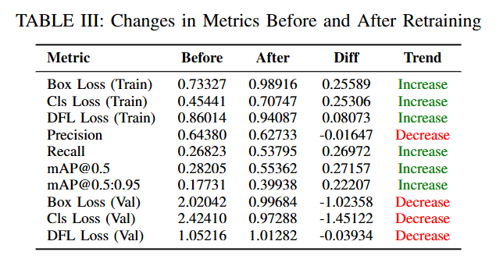
Before Retrain and After Retrain Metrics

Slide 35
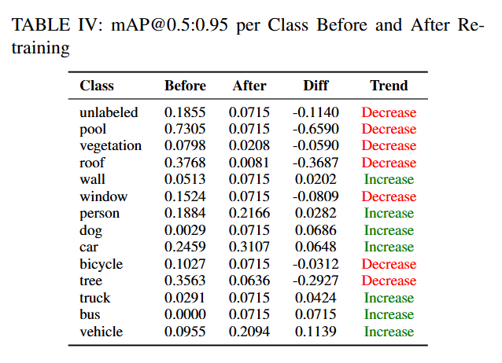
Before Retrain and After Retrain Per Class Comparison of mAP@0.5:0.95

Slide 36
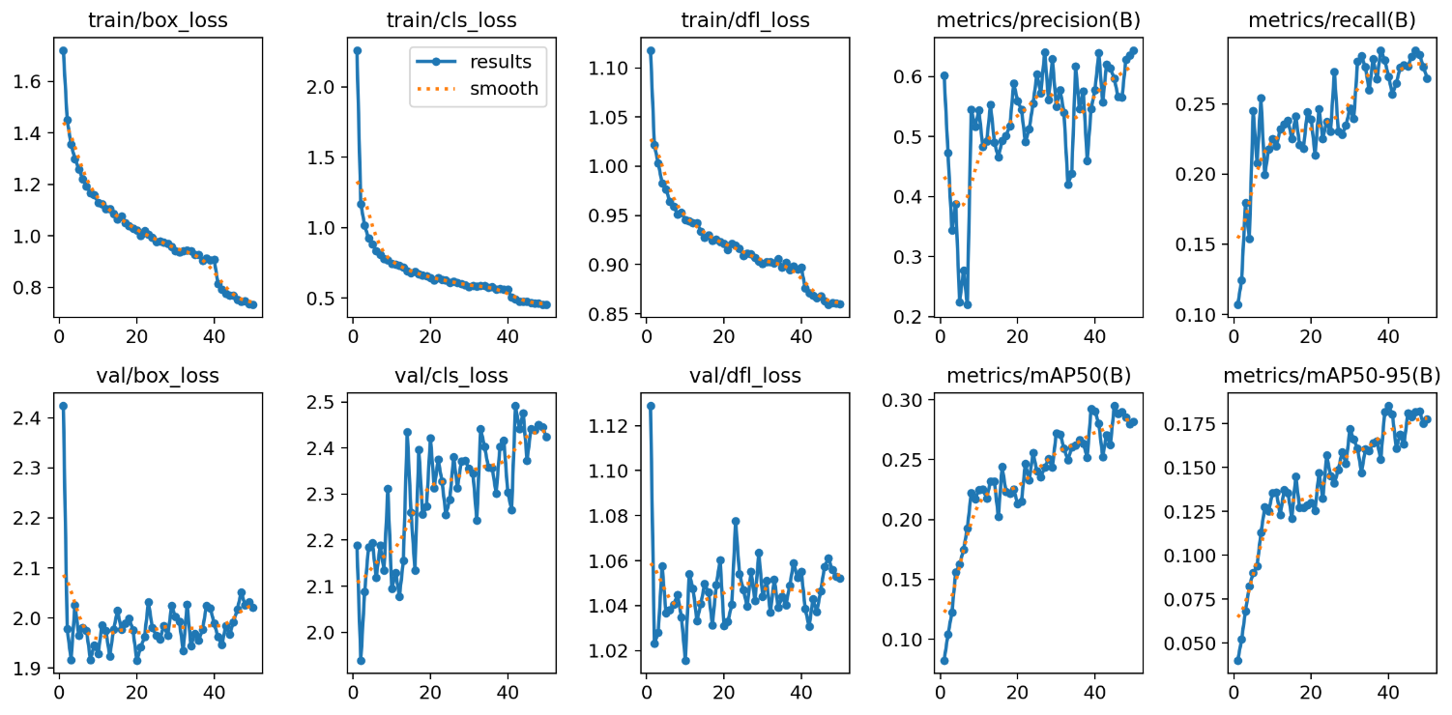
Before Retrain

Slide 37
Before Retrain
Aspect | Observation
Training Loss | Gradually decreased but quite slow.
Validation Loss | Fluctuated moderately; some overfitting signs.
Precision | Increased steadily with epochs.
Recall | Improved steadily with epochs.
mAP50 / mAP50-95 | Gradually improved over epochs, but still not very high.
Overall Stability | Reasonably stable training and validation behavior.
Problem | Slow convergence; potential for better performance with tuning.

Slide 38
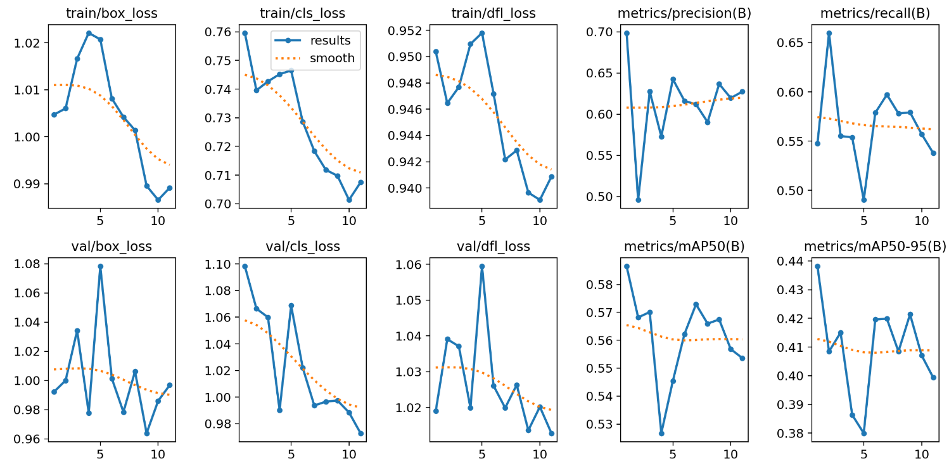
After Retrain

Slide 39
After Retrain
Aspect | Observation
Training Loss | Decreased faster and more smoothly.
Validation Loss | Highly unstable, fluctuating a lot.
Precision | Decreased compared to before retrain.
Recall | Decreased compared to before retrain.
mAP50 / mAP50-95 | Fluctuated without clear improvement; overall worse.
Overall Stability | Training stable, but validation unstable and worse.
Problem | Model overfitted to training data; generalization to unseen data worsened.

Slide 40
Summary:
Thank You

